Slide 1
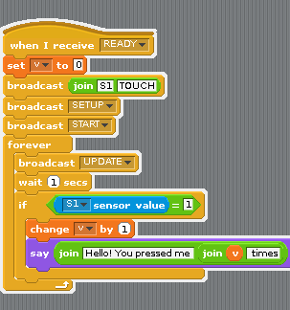
Setup: Start the Touch Sensor
Variable ‘v’ will count the
number of times the touch
sensor has been touched.
Set the sensor S1 as the
TOUCH sensor.
Setup and Start the Touch Sensor

Slide 2
Go! Start the For Loop
Start the Forever For Loop.
We want to check this over
and over.
Check the value of the sensor
Wait 1 second.
If the Touch Sensor was pressed:
Increment the counter ‘v’ by one.
Make the Scratch Cat say it was pressed.

Slide 3
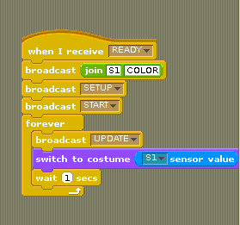
Setup the Color Sensor
Color sensor is going on Sensor Port 1.
Setup and Start the Color Sensor

Slide 4




Go! Start the Color Sensor
Forever Loop
Update the sensor value.
Based on the value of the color sensor, change the color of the Scratch Cat

Slide 5
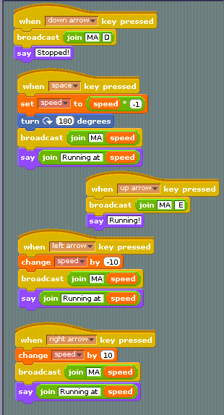
How to Run a Motor
Broadcast Command: Motor A (MA) “Stop” (D)
Broadcast Command: Motor A (MA) run at number value “speed”

Slide 6
Go! Start the Motors
If we press the down arrow, stop motor A.
If we hit the space bar, reverse motor B.
If we hit the up arrow, go full blast.
If we hit the left arrow, decrease the speed by 10.
If we hit the right arrow, increase the speed by 10.

